Slide 1
Skills Bootcamp Classroom Rules
Be on time: Just like in a physical classroom, it's important to be punctual for your online class. Log in to the virtual classroom a few minutes before the class starts.
Turn Cameras on: In order to maximise your learning studies show that being able to see your peers and your tutor being able to see you can increase motivations and retention, therefore we ask to keep your cameras on.
Attend all classes: In order to be successful in your bootcamp studies you need to attend all live sessions, therefore you should prioritise and make time for these sessions.
Avoid distractions: Turn off your phone notifications, close any other unnecessary tabs, and focus solely on the class.
Participate actively: It's important to be an active participant in the class. Ask questions, answer questions, and participate in discussions.
Use proper language and tone: Use respectful language and tone when communicating with your classmates and instructor. Avoid using slang or inappropriate language.
Respect others' opinions: Be respectful of others' opinions, even if they differ from your own. Avoid making negative comments or attacking others.
Follow the instructor's guidelines: Follow the instructor's guidelines, such as submitting assignments on time.
Be polite: Be polite and respectful to everyone in the class, including the instructor, classmates, and guest speakers.
Dress appropriately: Even though you are not in a physical classroom, it's important to dress appropriately. Dress as if you were going to a face-to-face class.
Use appropriate technology: Ensure that you have the necessary equipment, such as a reliable internet connection, a microphone, and a webcam, and that they are in good working condition.

Slide 2
Software Developer Bootcamp
Unit 3 – Coding and Architecture
Week 3C

Slide 3
Objectives
Following this session, you should be able to:
Develop a Logical Structure for the Application
Implement Good Coding Practices
Incorporate End-User Context into Application Design

Slide 4
Develop a Logical Structure for the Application

Slide 5

What is a Logical Structure?
A logical structure is the foundation of any application.
It is the blueprint that outlines the architecture of the application.
It is the basis for the design, development, and maintenance of the application.

Slide 6

Why is a Logical Structure Important?
A logical structure is important because it provides a solid foundation for the application.
It helps to ensure that the application is well-designed, efficient, and maintainable.
It also helps to ensure that the application is secure and reliable.

Slide 7

How to Develop a Logical Structure
Developing a logical structure for an application requires careful planning and strategy.
It is important to consider the goals of the application, the target audience, and the available resources.
It is also important to consider the design, development, and maintenance of the application.

Slide 8

Steps to Develop a Logical Structure
The steps to develop a logical structure for an application include:
1. Identify the goals of the application.
2. Identify the target audience.
3. Identify the available resources.
4. Design the application.
5. Develop the application.
6. Maintain the application.

Slide 9

Tools to Develop a Logical Structure
There are a variety of tools and technologies available to help develop a logical structure for an application.
These include:
1. Flowcharts
2. UML diagrams
3. Database design tools
4. Application development frameworks

Slide 10

Conclusion
Developing a logical structure for an application is an important step in the design, development, and maintenance of the application.
It is important to consider the goals of the application, the target audience, and the available resources.
There are a variety of tools and technologies available to help develop a logical structure for an application.

Slide 11
Good Coding Practices

Slide 12

Planning
Understand the problem
Break the problem into smaller tasks
Create a timeline for completion
Identify any potential risks

Slide 13
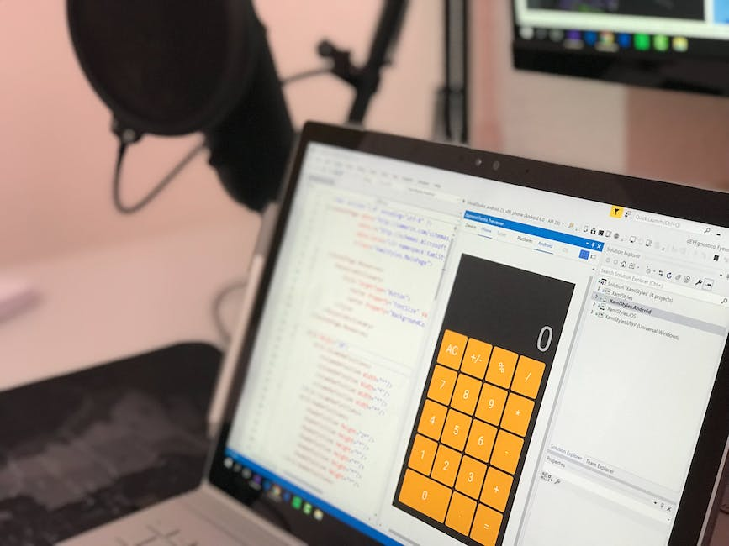
Documentation
Write comments to explain code
Create a README file to explain the project
Include a changelog to track changes
Document any assumptions made

Slide 14

Testing
Write unit tests to test individual functions
Write integration tests to test the entire system
Test for edge cases and error handling
Test for performance and scalability

Slide 15

Refactoring
Simplify code to make it more readable
Remove redundant code
Improve code performance
Ensure code is maintainable

Slide 16

Version Control
Use version control to track changes
Create branches for different features
Merge branches when features are complete
Keep a history of changes

Slide 17
Incorporate End-User Context into Application Design

Slide 18

What is End-User Context?
End-user context is the set of conditions that affect how a user interacts with an application.
It includes factors such as the user's device, location, language, and preferences.

Slide 19
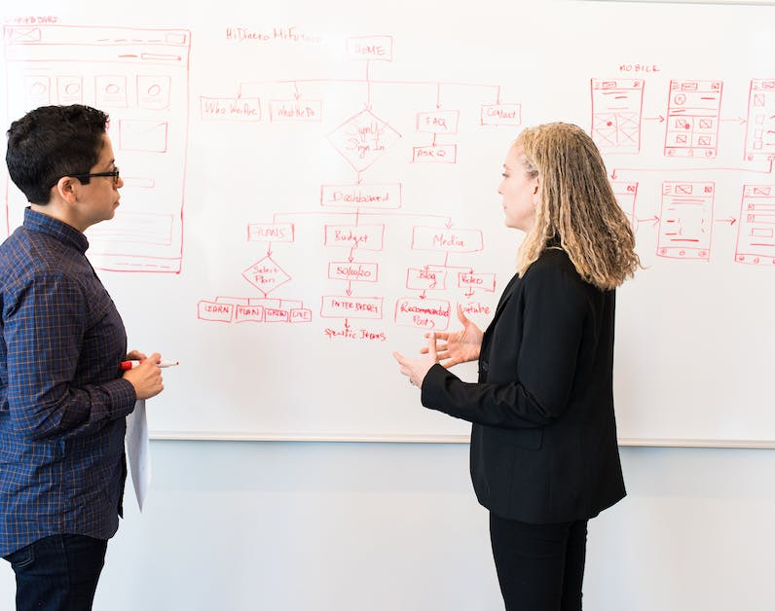
Why is End-User Context Important?
By understanding the user's context, you can create an application that is tailored to their needs.
This will create a more engaging user experience, which will lead to increased user satisfaction and loyalty.

Slide 20

How to Incorporate End-User Context
When designing an application, consider the user's context.
Think about the user's device, location, language, and preferences.
Design the application to be responsive to these factors, and create an experience that is tailored to the user's needs.

Slide 21

Device Context
When designing an application, consider the user's device.
Design the application to be responsive to different devices, such as desktop, tablet, and mobile.
This will ensure that the user has a consistent experience across all devices.

Slide 22

Location Context
When designing an application, consider the user's location.
Design the application to be responsive to different locations, such as different countries or regions.
This will ensure that the user has a localized experience.

Slide 23

Language Context
When designing an application, consider the user's language.
Design the application to be responsive to different languages.
This will ensure that the user has a localized experience in their own language.

Slide 24

Preferences Context
When designing an application, consider the user's preferences.
Design the application to be responsive to different preferences, such as color, font size, and layout.
This will ensure that the user has a personalized experience.

Slide 25

Benefits of Incorporating End-User Context
Incorporating end-user context into application design will create a more engaging user experience.
This will lead to increased user satisfaction and loyalty, as well as improved user retention.

Slide 26

Conclusion
Incorporating end-user context into application design is essential for creating an engaging user experience.
By understanding the user's context, you can create an application that is tailored to their needs, leading to increased user satisfaction and loyalty.

Slide 27
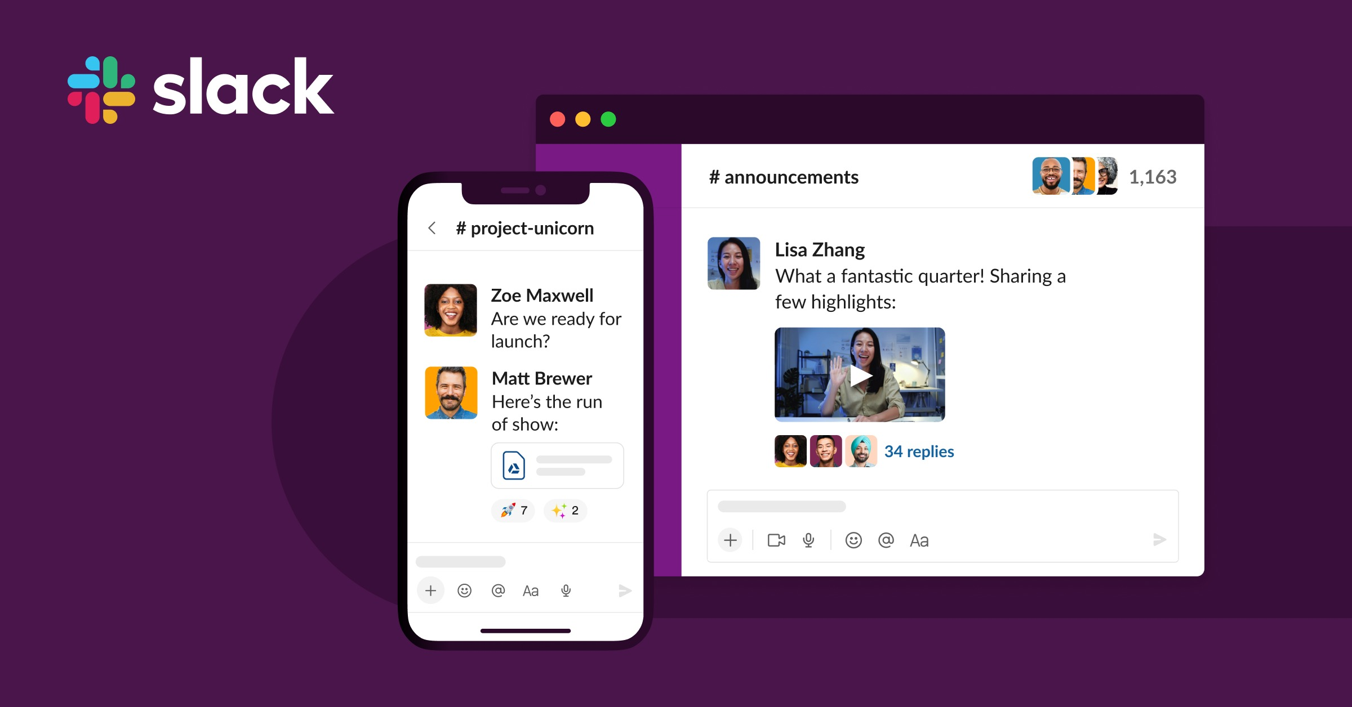
Case-Study - Slack's Software Development
Introduction to Slack's Software Development Approach
Good afternoon, everyone. Today, we'll explore an insightful case study about Slack, a widely used messaging platform. We will focus on understanding how Slack develops a logical structure for its application, implements good coding practices, and incorporates end-user context into its design. This aligns with our first SMART objective: Developing a Logical Structure for the Application."
Notes:
This case-study aims to provide a comprehensive understanding of how Slack approaches software development, from structuring the application logically to implementing good coding practices.

Slide 28
Case-Study - Slack's Software Development
Slack's Coding Practices
Slack employs a variety of good coding practices, such as code reviews, unit testing, and continuous integration. These practices ensure that the code is functional but also maintainable and scalable. This helps us understand our second SMART objective: Implement Good Coding Practices.

Slide 29
Case-Study - Slack's Software Development
End-User Context in Slack's Application Design
Slack places a strong emphasis on user experience. They conduct user interviews, A/B tests, and use analytics to understand how people use their platform. This information is then used to make informed design decisions, fulfilling our third SMART objective: Incorporate End-User Context into Application Design.

Slide 30
15-Minute Group Activity: "App Design Sprint"
This activity is based on the following Industry Case Study: Mobile App Development at a Local Grocery Store
Overview: A local grocery store has decided to develop a mobile app to enhance customer experience and streamline online shopping. The development team is tasked with creating a user-friendly, efficient, and maintainable app. This case study aims to help beginners understand how to develop a logical structure for an application, implement good coding practices, and incorporate end-user context into design decisions.
Objectives: Create a basic outline for the grocery store's mobile app that aligns with the SMART learning objectives.

Slide 31
15-Minute Group Activity: "App Design Sprint"
Instructions:
Each group will receive an Activity Worksheet outlining the case study.
Groups will sketch a basic outline of the app's main features, considering good coding practices and end-user needs.
Each group will discuss how they would incorporate user feedback into their design.

Slide 32
15-Minute Group Activity Material
Activity Worksheet: App Design Sprint
Case Study Overview: You are part of a development team at a local grocery store. Your task is to develop a mobile app to enhance the customer shopping experience.
Your Task:
1. Write a basic outline of the app's main features.
2. Discuss the good coding practices you would implement.
3. Explain how you would incorporate end-user context into your design.
Use the Example document to help you.

Slide 33
Objectives
Now, you should be able to:
Develop a Logical Structure for the Application
Implement Good Coding Practices
Incorporate End-User Context into Application Design

Slide 34

Questions?

Slide 35
Thank You

